Slide 1
EMPLOYEE SALES DATA ANALYSIS using excel
Student name: R.LIKITHA PRIYA
REGISTER NO: 312208516 asunm1330312208516
DEPARTMENT: B.COM(GENERAL)
COLLEGE:CHELLAMMAL WOMEN’S COLLEGE

Slide 2

PROJECT TITLE
Sales analysis report
DEALer Wise sales analysis
•Year-2023-2024
•REGion- india

Slide 3

Contents of sales data analysis
Product offering
Sales performance analysis report
Global smartphone market performance
Percentage of smartphone users in India 2024
Top 10 best smart phones In India 2024
New trends in smartphones
Smartphones with flip and AI technologies
Performances of smartphone in media
Financial results in 2024
Conclusion

Slide 4
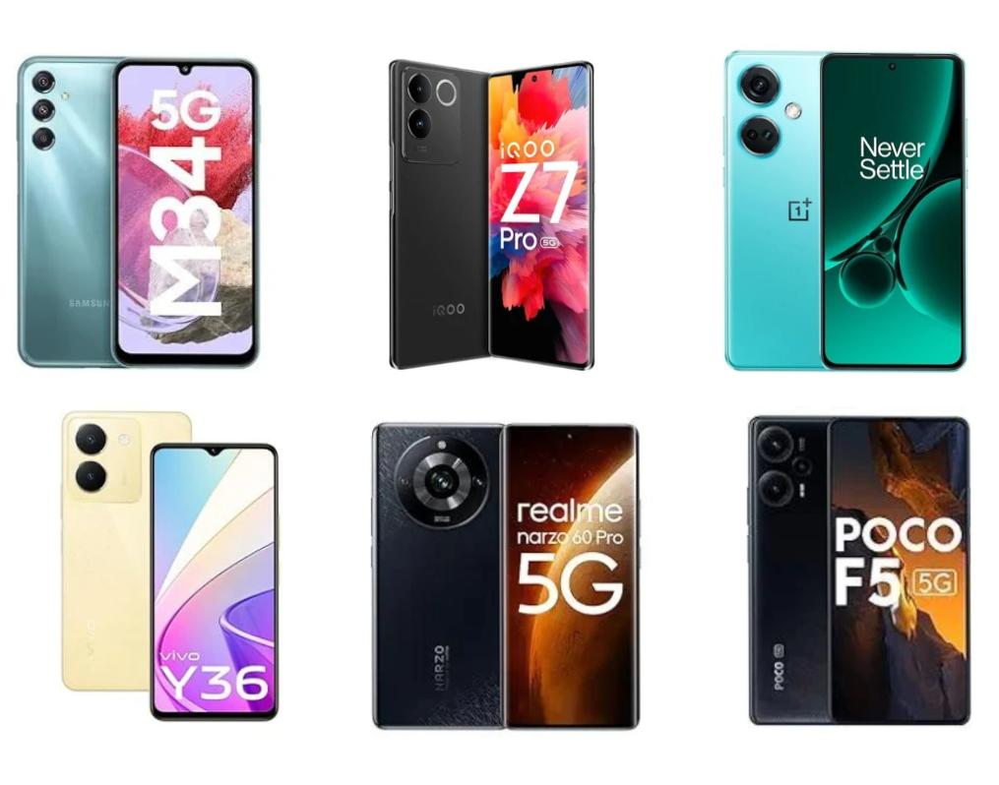
product offerings:latest smart phones Under 30k to 50k....

Slide 5
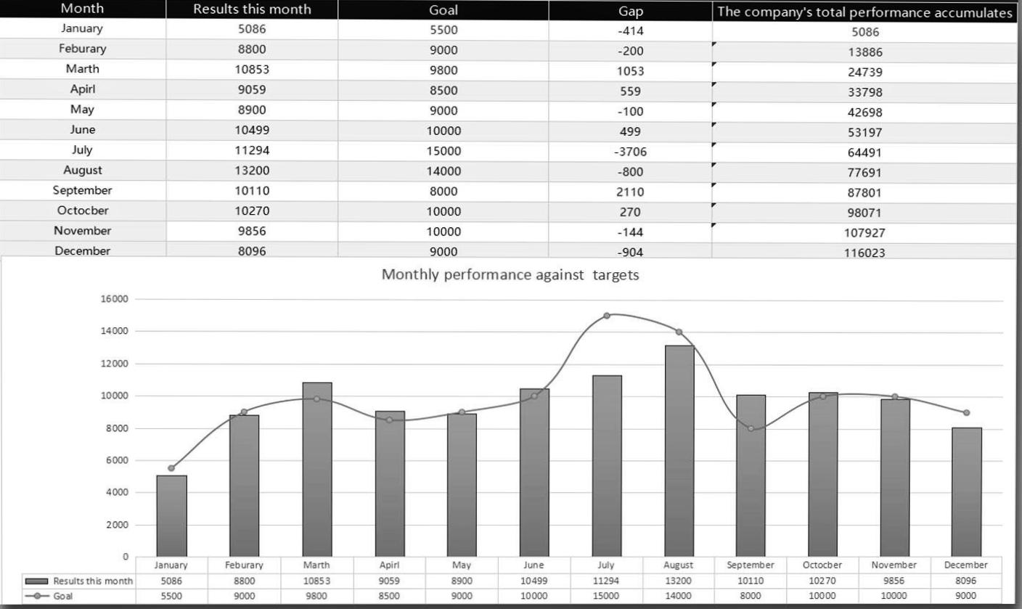
Sales Performance analysis Report

Slide 6
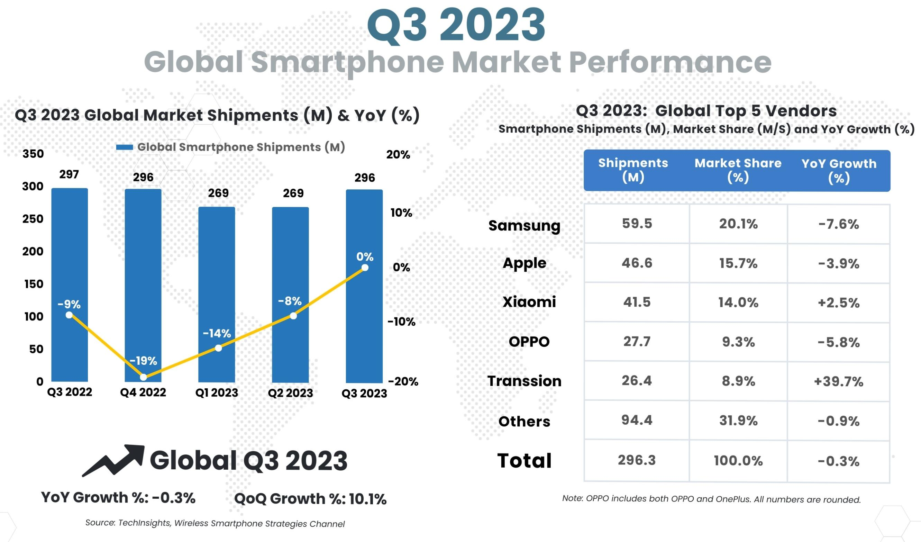
GlOBAL SMARTPHONE market PERFORMANCE

Slide 7
PeRcentage of Smartphone users in india 2024
There were 751.5 million internet users in India at the start of 2024, when internet penetration stood at 52.4 percent.
India was home to 462.0 million social media users in January 2024, equating to 32.2 percent of the total population.
A total of 1.12 billion cellular mobile connections were active in India in early 2024, with this figure equivalent to 78.0 percent of the total population.

Slide 8
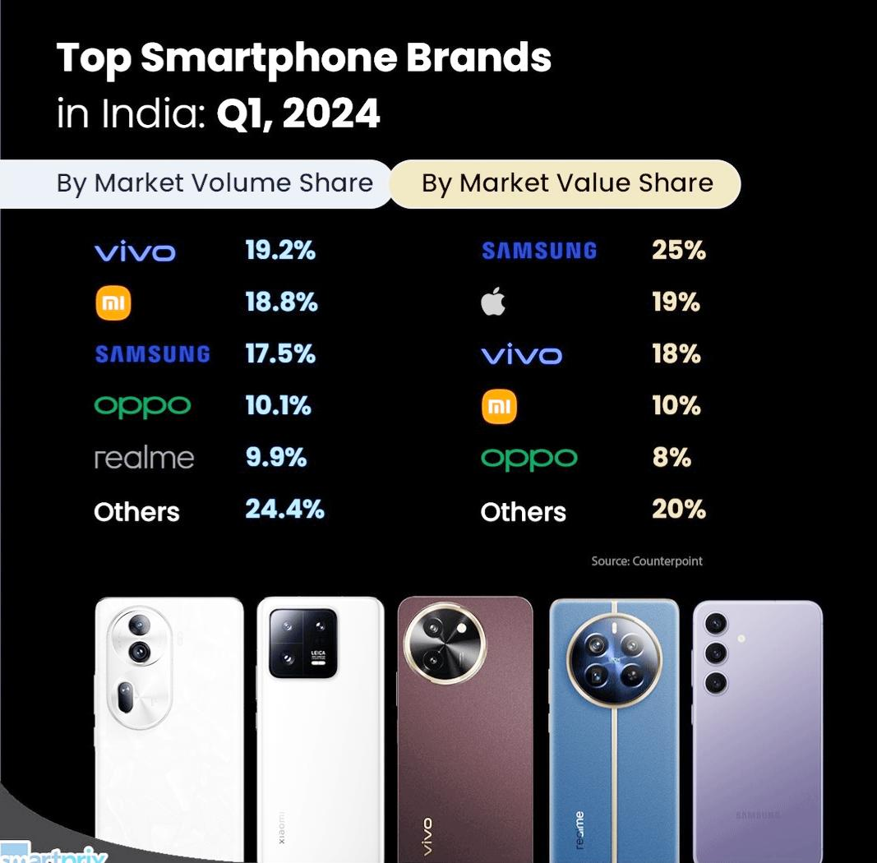
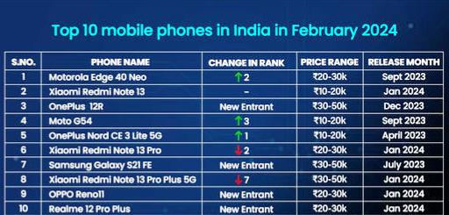
Top 10 best smartphones in india 2024 !

Slide 9
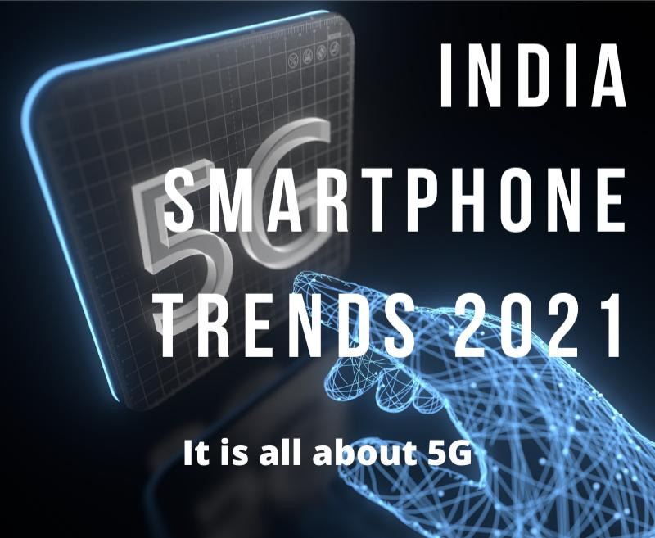
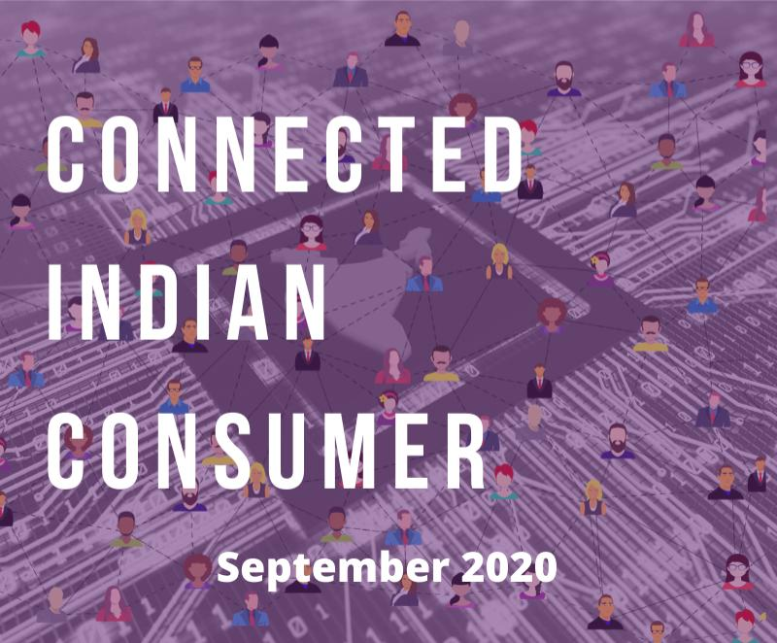
New trends in smart phones

Slide 10

Smartphones with FLIP and Ai technologies
Twenty years after the original razar set new standards for flip phone coolness, the razar 50 Ultra is back to do it all again. Moto has squeezed in the largest outer screen you’ll find on any flip-style foldable, as well as an even bigger battery than the outgoing modeling.
Artificial intelligence, or AI, is the phone world’s new favourite buzzword. Almost every upcoming smartphone has plans to incorporate machine learning and large language models in some form or another, and the first to do so are already on sale.

Slide 11


Performances of smartphones in media
Smartphone has penetrated across all regions of India and all sections of the society, especially among the higher education student community.

Slide 12
Financial results in 2024
In financial year 2023, the total revenue of Samsung India has reached 989.2 billion Indian rupees. It was a 16 percent increase in comparison to the previous year. However, the company reported a 10 percent decline in profit. Most of the revenue came from the smartphone segment.
Samsung Electronics has been recognized as the world's fifth highest-valued brand in 2023 in the latest report by global brand consultancy Interbrand.

Slide 13

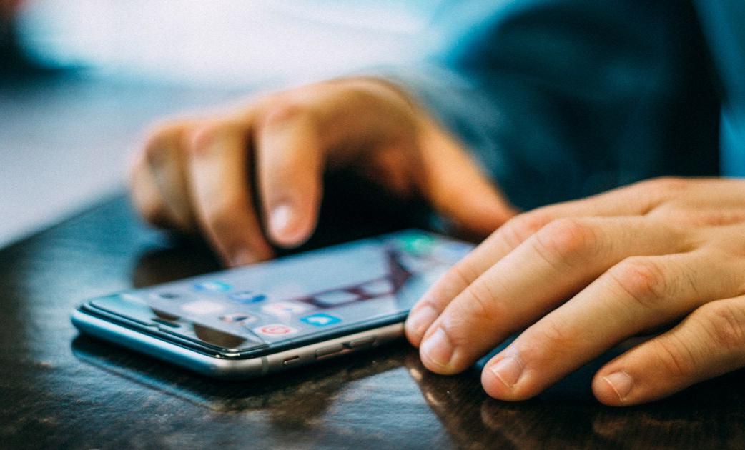
Conclusion
A mobile phone could both be positive and negative; depending on how a user Can uses it. As mobiles have become a part of our life. So, we should use it in a Proper Way, carefully for our better hassle- free life rather using it improperly and making it a virus in life.

Slide 14
Thank you !

